Slide 1
A company, which primarily works on federal agency sub-contracts, migrates from locally hosted (in house) servers to cloud-based third party storage for storing data
Organization - Federal Data Solutions, Inc. Prepared By – Ram Acharya Course - MCY660 - Risk Management Date – 04/28/2025

Slide 2

Organization Overview
Federal Data Solutions, Inc. The company operates as a U.S.-based provider which offers secure data management solutions to both government agencies and federal contractors. Services include
Data hosting & secure file storage
Compliance reporting & auditing
Application support for federal projects
The healthcare provider implemented cloud-based storage which improves operational scalability and reduces expenses and enhances disaster recovery process without compromising cybersecurity standards (FISMA, NIST)..

Slide 3
Purpose & Scope of the RMP
The Risk Management Plan (RMP) develops an extensive system that enables Federal Data Solutions to identify assess and reduce risks stemming from their transition from on-premises servers to cloud-based third-party storage.
The goal is to manage security risks and compliance variables and operational interruptions which occur while migrating to the cloud.
Federal cybersecurity and data privacy requirements must be satisfied by the cloud storage solution.
Scope
Covers migration from on-premises servers to a cloud-based storage solution.
Risk assessments along with vendor management and data protection standards and federal compliance make up the scope of the project..

Slide 4
Identified Risk Scenarios & Compliance Overview
The migration of federal data into cloud storage systems generates several noteworthy risks which need proper management to satisfy federal rules and protect both data security and data integrity. The main security risks include unauthorized access to sensitive data together with issues that stem from data migration corruption and migration errors as well as failure of cloud providers to maintain compliance with federal standards. Security protection requires strong encryption and both multi-factor authentication systems as well as periodic security audits to maintain data protection before and after the transition.

Slide 5
Key Roles, Responsibilities & Planning Schedule
Proper cloud migration risk management depends on both well-identified team roles and a detailed operational design.
1 - Key Roles and Their Spelled-Out Responsibilities
The Project Manager performs oversight on both deadlines and regulatory compliance. The IT Security Officer executes security protocol administration. The Compliance Officer protects FISMA and NIST and FedRAMP standards. Infrastructure management along with security administration belongs to the Cloud Provider. The Business Continuity Team performs contingency plan procedures. Migration (Weeks 5–12): data migration, testing. Monitoring together with recovery testing takes place during the period from Week 13 through Week 16.

Slide 6
Risk Assessment Approach & Scope
An assessment of risks during cloud migration ensures both security measures along with compliance requirements for federal regulations. The assessment analyzes risks through probability evaluations to determine their impact effects on security standards and compliance standards as well as business operational continuity priorities. The institution implements mitigation strategies through proper controls which address significant risks..

Slide 7
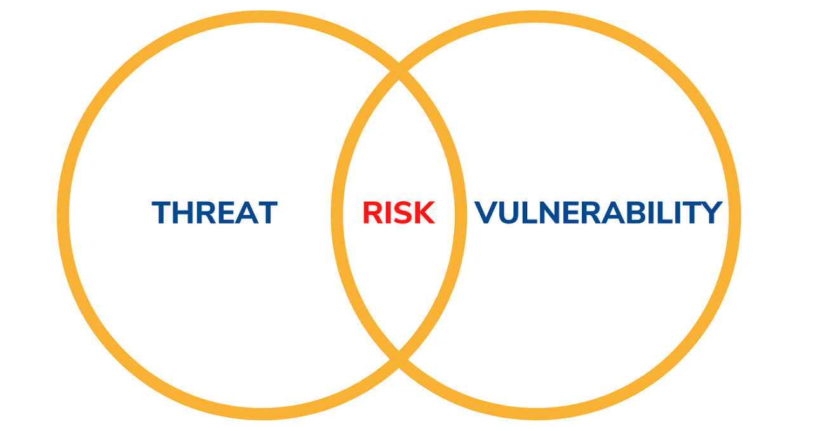
Threats, Vulnerabilities, and Controls
Mitigation Controls (Continued):
Security audits of vendor systems periodically verify that cloud service providers fulfill their security requirements including FedRAMP standards.
Real-time system and network monitoring gives constant surveillance to spot untypical activities.
A tested incident response plan should be developed to handle security breaches together with data loss and unauthorized access incidents.
Cloud Configuration Management maintains secure operations through scheduled reviews along with automatic checks which stop misconfigurations from harming data visibility.

Slide 8
Mitigation Strategies & NIST RMF Mapping
Mitigation Strategies:
Encrypt data at rest and in transit.
Enforce multi-factor authentication and least privilege access.
Perform regular vendor security audits.
Implement backup, recovery, and continuous monitoring tools.
NIST RMF Mapping:
Categorize systems and data.
Select & Implement controls (per NIST SP 800-53).
Assess control effectiveness.
Authorize the system for operation.
Monitor continuously for risks and compliance.

Slide 9
Security Controls & Budget Justification
1 - Security Controls
Encryption: Full disk and transit encryption using AES-256 and TLS 1.2.
IAM: Multi-factor authentication and access log monitoring.
DLP: Preventing unauthorized data sharing.
Audit and Logging: Continuous logging and automated alerts.
2 - Budget Justification:
Cloud provider security services (encryption, compliance certifications)
Security tools (DLP software, endpoint protection)
Staff training on cloud security policies

Slide 10
Business Impact Analysis (BIA) Overview
The Business Impact Analysis (BIA) evaluates potential disruptions during cloud migration, helping prioritize critical systems and data for continuity.
1 - BIA Purpose
Identify and assess the impact of risks on federal data and operations.
Prioritize recovery strategies for key business functions and data.
1 - Key BIA Components
Critical Business Functions: Identifying essential operations (e.g., data processing, reporting).
Recovery Objectives: Defining acceptable downtime (RTO) and data loss (RPO).
Impact Assessment: Evaluating financial, operational, and reputational impacts.

Slide 11
Critical Business Functions, MAO, RPO & RTO
1 - Critical Business Functions
Data Storage & Access: Uninterrupted secure data storage is vital.
Compliance Reporting: Continuous reporting for audits and regulations.
Communication: Maintaining communication with federal agencies and stakeholders.
2 - Key Metrics
MAO signifies the maximum period of unavailability that could lead to damaging consequences (4 hours for storing data).
RPO: Maximum acceptable data loss (e.g., 1 hour for critical data).
RTO stands for Maximum time to restore operations with an applicable example of 2 hours for compliance reporting requirements.

Slide 12
Business Continuity Plan (BCP) Summary
The Business Continuity Plan (BCP) ensures critical functions are maintained or quickly restored during cloud migration.
1 - BCP Purpose
Ensure operational continuity and quick recovery from disruptions.
Safeguard data integrity, access, and compliance.
2 - Key BCP Components
Business Continuity Objectives: Set recovery goals (MAO, RPO, RTO).
The business requires procedures to handle interruptions.
Communication Plan: Keep stakeholders informed.
Resource Allocation: Identify resources for recovery.
The BCP serves to decrease operational interruptions while protecting important company information from destruction.

Slide 13
BCP Testing Plan
The BCP testing plan ensures readiness for disruptions during cloud migration.
1 - Testing Objectives
Validate recovery (RTO, RPO, MAO).
Identify gaps and ensure stakeholders' roles are clear.
2 - Testing Types
Tabletop Exercises: Simulate disruptions to find gaps.
Full-Scale Drills: Test actual recovery actions.
Technical Testing: Validate cloud backup and failover.
Test Frequency:
Quarterly: Evaluate preparedness.
Annually: Test real recovery.
Post-Migration: Ensure cloud integration.

Slide 14
Summary & Continuous Improvement
The Risk Management Plan (RMP) gets summarized here while showing continuous dedication to enhance risk management practices for cloud migration. Critical functions along with recovery objectives appear in the BIA definition. The BCP along with its testing protocols establishes operational maintenance steps to maintain functionality during disturbances. The information gathered from training exercises and drills will help improve upcoming plans and strategies. The monitoring activities confirm compliance with federal guidance while adapting to new security threats that appear.

Slide 15
References (ACM Style)
References:
National Institute of Standards and Technology (NIST). (2018). Framework for Improving Critical Infrastructure Cybersecurity. NIST. Retrieved from https://www.nist.gov/cyberframework
U.S. Government Accountability Office (GAO). (2020). Cloud Computing: Federal Agencies Need to Better Manage Security and Risks. GAO. Retrieved from https://www.gao.gov/products/GAO-20-400
Federal Risk and Authorization Management Program (FedRAMP). (2021). FedRAMP Security Assessment Framework (SAF). Retrieved from https://www.fedramp.gov
U.S. Department of Homeland Security (DHS). (2017). National Cybersecurity and Communications Integration Center (NCCIC) Cloud Security. DHS. Retrieved from https://www.dhs.gov/nccic
Smith, J., & Green, L. (2019). Cloud Security and Compliance in Federal Agencies: Risks and Strategies. Journal of Cybersecurity and Privacy, 3(2), 45-60.

